Slide 1
CHAPTER 2:
Guidelines, Principles, and Theories
Designing the User Interface:
Strategies for Effective Human-Computer Interaction
Fifth Edition
Ben Shneiderman & Catherine Plaisant
in collaboration with
Maxine S. Cohen and Steven M. Jacobs

Slide 2
Guidelines, Principles, and Theories
User-interface designers have accumulated a wealth of experience and researchers have produced a growing body of empirical evidence and theories, all of which can be organized into:
  Specific and practical guidelines that prescribe good practices and caution against dangers.
  Middle-level principles to analyze and compare design alternatives.
  High-level theories and models that describe objects and actions with consistent terminology so that comprehensible explanations can be made to support communication and teaching.

Slide 3
Guidelines
A guidelines document helps by developing a shared language and then promoting consistency among multiple designers in terminology usage, appearance, and action sequences.
It records best practices derived from practical experience or empirical studies, with appropriate examples and counter examples.
Critics: Too specific, incomplete, hard to apply, and sometimes wrong

Slide 4
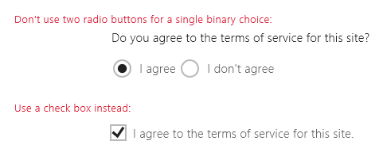
Guidelines for Navigating the interface
  Standardize task sequences
  Use thumbnails to preview large images
  Ensure that embedded links are descriptive
  Use unique and descriptive headings
  Use check boxes for binary choices
2-<number>

Slide 5
Accessibility guidelines
Text alternatives. Provide text alternatives for any non-text content so that it can be changed into other forms people need, such as large print, braille, speech, symbols, or simpler language.
Time-based media. Provide alternatives for time-based media (e.g., movies or animations). Synchronize equivalent alternatives (such as captions or auditory descriptions of the visual track) with the presentation.
Distinguishable. Make it easier for users to see and hear content, including separating foreground from background. Color is not used as the only visual means of conveying information, indicating an action, prompting a response, or distinguishing a visual element.
Predictable. Make web pages appear and operate in predictable ways.
2-<number>

Slide 6
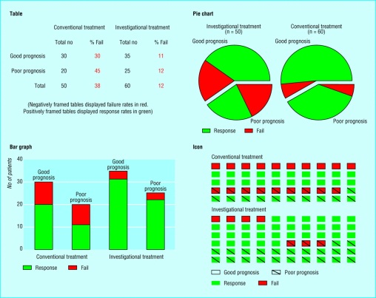
Organizing the display
  Consistency of data display
  Efficient information assimilation by the user
  Minimal memory load on the user
  Compatibility of data display with data entry
  Flexibility for user control of data display
2-<number>

Slide 7
Getting the user's attention
These guidelines detail several techniques for getting the user's attention:
Intensity. Use two levels only, with limited use of high intensity to draw attention.
Marking. Underline the item, enclose it in a box, point to it with an arrow, or use an indicator such as an asterisk, bullet, dash, plus sign, or X.
Size. Use up to four sizes, with larger sizes attracting more attention.
Choice of fonts. Use up to three fonts.
Inverse video. Use inverse coloring.
Blinking. Use blinking displays (2-4 Hz) or blinking color changes with great care and in limited areas.
Color. Use up to four standard colors, with additional colors reserved for occasional use.
Audio. Use soft tones for regular positive feedback and harsh sounds for rare emergency conditions.
2-<number>

Slide 8
Principles
More fundamental, widely applicable, and enduring than guidelines
Need more clarification/interpretation
Fundamental principles
  Determine user’s skill levels
  Identify the tasks
2-<number>

Slide 9
Determine user’s skill levels
Design goals based on skill level:
Novice or first-time users. True novice users—for example, grandparents sending their first e-mail to a grandchild—are assumed to know little of the task or interface concepts. By contrast, first-time users are often professionals who know the task concepts well but have shallow knowledge of the interface concepts.
Knowledgeable intermittent users. Many people are knowledgeable but intermittent users of a variety of systems (for example, corporate managers using word processors to create templates for travel reimbursements).
Expert frequent users. Expert "power" users are thoroughly familiar with the task and interface concepts and seek to get their work done quickly.
2-<number>

Slide 10
Identify the tasks
After carefully drawing the user profile, the developers must identify the tasks to be carried out.
Every designer would agree that the set of tasks must be determined before design can proceed, but too often, the task analysis is done informally or incompletely.
High-level task actions can be decomposed into multiple middle-level task actions, which can be further refined into atomic actions that users execute with a single command, menu selection, or other action.
2-<number>

Slide 11
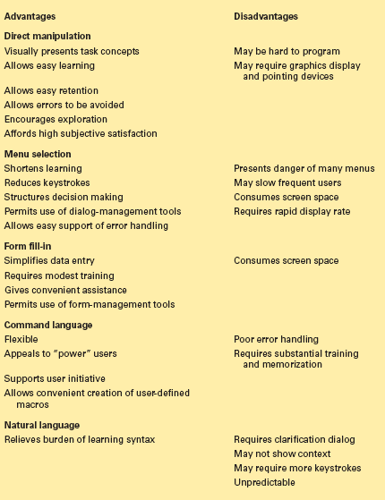
Interaction styles
Direct Manipulation
Menu selection
Form fill-in
Command language
Natural language
Refer the book for description
2-<number>

Slide 12
Schneiderman’s 8 golden rules of interface design
Strive for consistency
Cater to universal usability
Offer informative feedback
Design dialogs to yield closure
Prevent errors
Permit easy reversal of actions
Support internal locus of control
Reduce short term memory load
Refer the book for description
2-<number>

Slide 13
Theories
  Beyond the specifics of guidelines
  Principles are used to develop reliable, broadly useful theories
  Theories – descriptive, explanatory prescriptive or predictive
  Theories concern: motor, perceptual, or cognitive skills
2-<number>

Slide 14
More on theories
Descriptive theories
  provide consistent terminology
Explanatory theories:
  Observing behavior
  Describing sequence of activities
  Conceiving of designs
  Comparing high-level concepts of designs
Prescriptive theories:
  Giving designers clear guidance for choices
Predictive theories:
  Enable designers to compare proposed designs for execution time or error rates
2-<number>

Slide 15
Theories are according to
Perceptual, Cognitive, & Motor Skills
Another way to group theories is according to the types of skills involved:
Motor skill performance theories are well established and accurate for predicting key stroking or pointing times.
Perceptual theories have been successful in predicting reading times for free text, lists, formatted displays, and other visual or auditory tasks.
Cognitive theories, involving short term, working, and long-term memory, are central to problem solving and play a key role in understanding productivity as a function of response time.
2-<number>

Slide 16
Design-by-Levels
One approach to developing descriptive theories is to separate concepts according to levels.
The conceptual level is the user's "mental model" of the interactive system.
The semantic level describes the meanings conveyed by the user's input and by the computer's output display.
The syntactic level defines how the user actions that convey semantics are assembled into complete sentences that instruct the computer to perform certain tasks.
The lexical level deals with device dependencies and with the precise mechanisms by which users specify the syntax.
2-<number>

Slide 17
Consistency
An important goal for designers is a consistent user interface.
Consistency for objects and actions/commands
Consistent use of color, layout, icons, fonts, button sizes etc.
If terminology for objects and actions is orderly and describable by few rules, users will be able to learn and retain them easily.
2-<number>

Slide 18
Consistency
This example illustrates consistency and two kinds of inconsistency (A illustrates lack of consistency, and B shows consistency except for a single violation):
Consistent | Inconsistent A | Inconsistent B
delete/insert table delete/insert column delete/insert row delete/insert border | delete/insert table remove/add column destroy/create row erase/draw border | delete/insert table remove/insert column delete/insert row delete/insert border
Each of the actions in the consistent version is the same, whereas the actions vary for inconsistent version A.
The inconsistent action verbs are all acceptable, but their variety suggests that they will take longer to learn, will cause more errors, will slow down users, and will be harder for users to remember.
Inconsistent version B is somehow more startling, because there is a single unpredictable inconsistency; it stands out so dramatically that this language is likely to be remembered for its peculiar inconsistency.
2-<number>

